Slide 1

Measurement & Questionnaire Design
W
E
E
K
MKTG 2341-09

Slide 2
Learning Objectives
Chapter 8: Using Measurement Scales
Basic concepts of measurement and scaling.
Commonly used scales in Marketing Research.
Chapter 9: Questionnaire Design
The role of the questionnaire.
Criteria for a good questionnaire.
Steps in the questionnaire design process.

Slide 3

Basic Question-Response Formats
Open-ended
Closed-ended
Scaled-response
… each have several sub-categories
Notes:
Three basic types of Question-Response Formats
Each have sub categories

Slide 4
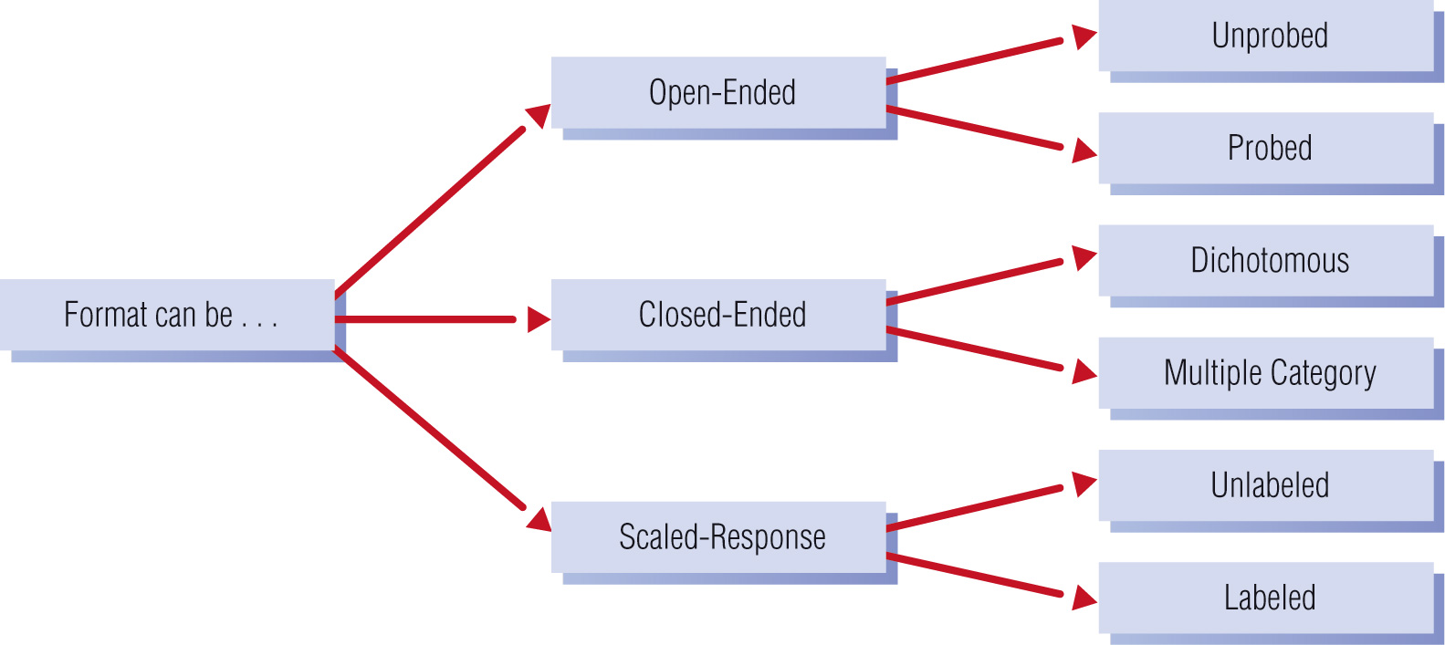
Basic Question-Response Formats

Slide 5
Open-Ended Formats
Open-ended question presents no response options to the respondent.
  Unprobed format
  Seeks no additional information
  Probed format
  Instructions for the interviewer to ask for additional information
Notes:
UNPROBED FORMAT:
Advantage:
Allows respondent to use his or her own words
Disadvantages:
Difficult to code and interpret
Respondents may not give complete answers
PROBED FORMAT:
Advantage:
Elicits complete answers
Disadvantages:
Difficult to code and interpret

Slide 6
Open-Ended Format
Open-ended question :
  Unprobed:
  What brands of beer have you purchased in the past month? ___________________________
  Probed:
  Any other brands? _____________________
Notes:
UNPROBED FORMAT:
Advantage:
Allows respondent to use his or her own words
Disadvantages:
Difficult to code and interpret
Respondents may not give complete answers
PROBED FORMAT:
Advantage:
Elicits complete answers
Disadvantages:
Difficult to code and interpret

Slide 7
Open-Ended: Unprobed
Unprobed format seeks no additional information
Advantage: Allows respondent to use his or her own words | Disadvantages: Can sometimes be difficult to code and interpret Respondents may not give complete answers

Slide 8
Open-Ended: Probed
Probed format includes a response probe instructing the interviewer to ask for additional information
Advantage: Elicits complete answers | Disadvantages: Can sometimes be difficult to code and interpret

Slide 9
Open-Ended: Probed
One common difficulty with probed responses is determining which of the respondents’ several responses is of most importance to them.
Question: Can you think of ways to get around this problem?
Notes:
Answer: Ask respondent to identify the single most important item/issue/features first (e.g., “What is the single most important feature of your new home?”), then ask a follow-up question such as “Are there any other features that are important to you?

Slide 10
Closed-Ended Formats
Closed-ended questions provide response options so that respondents can answer quickly and easily.
Two main types of closed-ended questions:
  Dichotomous
  Multiple response
Notes:
DICHOTOMOUS
Advantage:
Simple to administer and code
Disadvantages:
May oversimplify response options
MULTIPLE RESPONSE
Advantages:
Allows for broad range of possible responses
Simple to administer and code
Disadvantages:
Must distinguish “pick one” & “pick all that apply”
Point to responses they may be unaware of

Slide 11
Closed-Ended: Dichotomous
Dichotomous Questions have only two response options, such as male/female, yes/no
Advantage: Simple to administer and code | Disadvantages: May oversimplify response options

Slide 12

Closed-Ended: Multiple Response
Multiple Response Questions have more than two response options.
Please indicate which of the following brands of beer you have bought in the past six months: CHECK ALL THAT APPLY
Notes:
IMPORTANT:
For Multiple Response questions the researcher must specify either:
Choose one only or
Check all that apply, i.e. allow more than one answer to be circled
NOTE: For questions with “all that apply”:
See note about coding for this type of response.
The researcher can use a Summated Scale – the number of check-marks will be counted for each consumer. That number will then be the measure for that construct. Ex the summated score for the person circling 6 brands of beer in the above example will be higher than the person who has just bought one brand.

Slide 13
Closed-Ended: Multiple Response
Advantage: Allows for a broad range of possible responses Simple to administer and code | Disadvantages: Could bias responses by giving respondents information (answer categories) that they may not have known about or that are no longer ‘top of mind’.

Slide 14

Scaled-Response
Scaled-Response question
  Utilizes a scale developed by the researcher (or someone else).
  Measures the intensity of the variable such as attitudes or brand preference.
Even if there is a sale on the other brands, I still buy Granville Island Beer
Always Usually Usually Always Don’t
False False True True Know
1 2 3 4 5

Slide 15
Scaled-Response
Unlabeled uses a scale that may be purely numerical or only the endpoints of the scale are identified
Labeled uses a scale in which all points on the scale are identified with some description
Notes:
UNLABELED SCALES
Advantages:
Allows for degree of intensity/feelings to be expressed
Simple to administer and code
Disadvantages:
Respondents may not relate well to the scale
LABELED SCALES
Advantage:
Allows for degree of intensity/feelings to be expressed
Simple to administer and code
Respondents can relate to scale
Disadvantages:
Scale may be “forced” or overly detailed

Slide 16
Scaled-Response: Unlabeled
Advantage: Allows for degree of intensity/feelings to be expressed. Simple to administer and code. | Disadvantages: Respondents may not relate well to the scale. Respondents’ interpretation of points on the scale might differ.

Slide 17
Scaled-Response: Labeled
Advantage: Allows for degree of intensity/feelings to be expressed. Simple to administer and code. Respondents can relate to scale. | Disadvantages: Scale may be “forced” or overly detailed.

Slide 18
How to Choose a Question Format
Factors influencing the question format:
What is being measured
  E.g., intensity – use a scale
Previous research studies
  Use same format used in previous study if you want to be able to compare the results
Desired type of measurement and analysis
  Do you need Nominal, Ordinal, Interval or Ratio data?

Slide 19
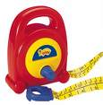
How to Choose a Question Format
Factors influencing the question format (cont’d):
The data collection method
  Complicated scales may require visual aids.
  Only simple scales should be used on the phone.
The ability of the respondent
  Kids don’t relate to scales
  like adults do.

Slide 20

Two Important Research Dimensions
Measurement
Dimension
Objects
Properties
Measurement
Scale
Dimension
Description
Order
Distance
Origin
Notes:
Measurement:
Determining how much of a property is possessed by an object that can be used to distinguish it from another object
Objects:
What or who we are measuring.
Such as consumers, stores, brands, ads.
Properties:
specific features or characteristics

Slide 21
First, let’s look at the
Measurement Dimension

Slide 22

Measurement Dimension
Objects:
What or who we are measuring. Examples could include consumers, stores, brands, ads.
  E.g., Measure consumer attitudes towards mall shopping.

Slide 23
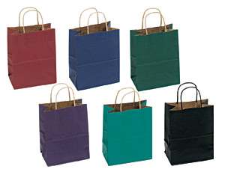
Measurement Dimension
Properties: specific characteristics of an object
Other terms for ‘properties’:
  variables
  attributes
  qualities
  characteristics
Notes:
Example:
If the Objects we are measuring are products, the properties could include:
Colour
Packaging
Features
Level of Quality etc
If the Objects we are measuring are consumers, the properties could include:
Brand loyalty
Satisfaction
Heavy/light users
If the Objects we are measuring are advertisement, the properties could include:
Brand recall
Brand recognition
Level of impact etc.

Slide 24
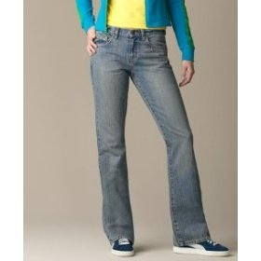
Measurement Dimension
Measurement:
Determining how much of a property is possessed by an object that can be used to distinguish it from another object.
  E.g., measure consumer perception of:
  Property: style
  Object: Calvin Klein jeans
Notes:
The very reason we use measurements in marketing research is to help the manager formulate strategies.

Slide 25
Measurement Dimension
Two types of properties:
Objective properties: physically verifiable
  E.g., age, income, number of cars owned
Subjective properties: mental constructs
  Researchers must translate this onto a scale
  E.g., attitude, satisfaction, degree of intention
Notes:
Subjective properties cannot be directly observed because they are mental constructs such as a person’s attitudes, opinions, or intentions.
For subjective properties, researchers must translate mental constructs onto an intensity continuum = scale

Slide 26
Now let’s look at the
Scale Dimension

Slide 27

Now let’s look at the Scale Dimension
Description: unique labels, identifying each answer or unit on the scale
  All scales have description – lowest level of measurement is ‘nominal’
  E.g., male/female
  E.g., satisfied/dissatisfied
Notes:
Scale characteristics determine the level of measurement

Slide 28
Scale Dimension
Order: relative positions of the descriptors are known (i.e., ‘ordinal’).
Indicates “greater than / less than”
Please rank the following fast-food restaurants from most preferred to least preferred. Rank
    McDonald’s ____
    Burger King ____
    Dairy Queen ____
    A & W ____
Notes:
This tell you the most preferred restaurant but it does not tell you the distance i.e. how much you prefer the first more than the rest or how close they are in your level of preference.

Slide 29
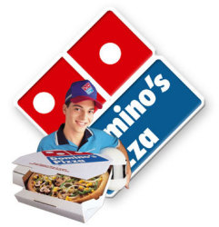
Scale Dimension
Distance: distance between descriptors is known (i.e., ‘interval’).
Please indicate how satisfied you are with the speed of your pizza delivery.
Very Dissatisfied Neither Satisfied Very
Dissatisfied Satisfied
1 2 3 4 5

Slide 30
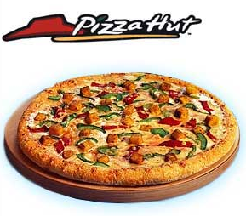
Scale Dimension
Origin: there is a true, natural zero (i.e., we can calculate a ‘ratio’).
$19.99 for a large pizza from Pizza Hut is exactly $2 more than $17.99 from Domino’s Pizza, and $2 represents a savings of 10%.

Slide 31
Scale Dimension
Each of the 4 Scale Characteristics build on the previous one:
  Description
  Order
  Distance
  Origin
  Now let’s tie it together …
Notes:
If a scale has a higher-level characteristics it also has all the lower-level characteristics

Slide 32
Levels of Measurement Scales

Slide 33
Levels of Measurement Scales
Type of Scale Required
Level of
Measurement
Affects
Scale Characteristics that you require will determine the Level of Measurement that you can use and vice-versa.

Slide 34
Levels of Measurement Scales
Four levels of
Measurements:
Nominal scales: only labels
Ordinal scales: rank-order
Interval scales: equal distance b/w labels
Ratio scales: a true zero

Slide 35
Levels of Measurement Scales
 |  | Description | Order | Distance | Origin
 | Nominal | Yes | No | No | No
 | Ordinal | Yes | Yes | No | No
 | Interval | Yes | Yes | Yes | No
 | Ratio | Yes | Yes | Yes | Yes
Scale Characteristics
Categorical
Scale
Metric
Scale
Notes:
How to read this matrix:
If you only have Description you use a Nominal scale
If you have Description and Order you use a Ordinal scale
If you have Description, Order and Distance you use a Interval scale
If you have Description, Order, Distance and Origin you use a Ratio scale
So what does this mean in the real life of a Marketing Researcher? – let’s look at some examples…

Slide 36
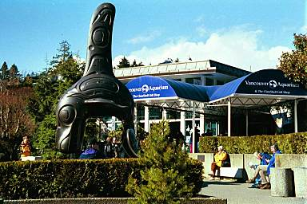
Examples of Scaling
Nominal
Have you visited Vancouver Aquarium in the past year?
___ Yes
___ No
Notes:
If you only have Description (categories)you use a Nominal scale

Slide 37

Examples of Scaling
Ordinal
Please rank your interest in the following exhibits:
Rank
Sea Lions ____
Belugas ____
Sea Otters ____
Notes:
Remember the fast food example earlier (slide 25)? It talked about ORDER of the measurement.
If you have Description and Order you use a Ordinal scale
This tell you the most preferred exhibt but it does not tell you the distance i.e. how much you prefer the first more than the rest or how close they are in your level of preference.

Slide 38
Examples of Scaling
Interval
Please rate your level of satisfaction with the following Vancouver Aquarium exhibits.
Not at all Extremely
Satisfied Satisfied
Outdoor Exhibits 1 2 3 4 5
Indoor Exhibits 1 2 3 4 5
Notes:
If you have Description, Order and Distance you use a Interval scale
NOTE
Most scales used in Marketing Research are “assumed interval scales”.
We assume that the distance between the scale labels are equal.
Technically speaking they are only ordinal scales.

Slide 39

Examples of Scaling
Ratio
How many times have you visited the Tropical Exhibit at Vancouver Aquarium in the past year? ____
Notes:
If you have Description, Order, Distance and Origin you use a Ratio scale
Gives an exact number - $, quantity, market share etc.

Slide 40
Why is Level of Measurement Important?
Measurement level of a scale is important because it determines:
What you can or cannot say about your object.
Ratio scales contain the greatest amount of information.
The type of statistical analyses you can use.
Ratio scales permit the most sophisticated analyses.

Slide 41
Why is Level of Measurement Important?
Example:
If you have a nominal or ordinal scale, you must summarize the data with a frequency distribution.
If you use an interval or ratio scale, you can calculate an average and run sophisticated statistics.

Slide 42
Scale Characteristics
When selecting a scale, you need to consider three things:
  Balanced vs. non-balanced scale
  Number of categories
  Forced vs. unforced scale
Notes:
Balanced vs. non-balanced
Balanced: has the same number of positive and negative categories. Used if no prior knowledge about the distribution of the answers.
Unbalanced: used if previous research indicates that most of the answers are in one end of the scale.
Number of categories
Typically between 5-9 categories.
Smaller sample size often require shorter scales to facilitate meaningful cross tabulations.
In your research use 5 or 6 points
Forced vs. unforced
Even numbered scales have no neutral point – must include a don’t know category
Odd numbered scales have neutral point – gives the “lazy” or uninvolved respondent an easy way out.

Slide 43
Scales Used in Marketing Research
Modified Likert Scale
Life-Style Inventory
Purchase Intent
Semantic Differential Scale
Many other types of scales
Notes:
See Handbook of Marketing Scales

Slide 44
Modified Likert Scale
Measures intensity of agreement or disagreement
Please indicate how much you agree or disagree with the following statement:
Axe makes me feel confident when dating.
Strongly Strongly
Disagree Disagree Neutral Agree Agree
1 2 3 4 5
Notes:
The score is a measure of the respondent’s attitude – in this example towards studying marketing.

Slide 45
Life-Style Inventory
Measures a person’s activities, interests, and opinions with a Likert scale.
Please indicate how much you agree or disagree with the following statement: “I view online dating as:”
Strongly Strongly
Disagree Disagree Neutral Agree Agree
A good way 1 2 3 4 5
to meet someone

Slide 46
Purchase Intent
Measures a person’s plans to buy or not to buy a product – using a Likert scale.
Please indicate how likely you are to choose the following brands for your next deodorant:
Very Very
Unlikely Likely
Axe 1 2 3 4 5
Degree 1 2 3 4 5
Notes:
Considered one of the “Key Question” in surveys researching a product/service/company.
NOTE: all questionnaires should have a “Key Question” (can be other information than the purchase intent, depending on the research objective).
Purchase intent is a good predictor of consumer choice of frequently purchased and durable consumer products.
Not a 1:1 ratio

Slide 47
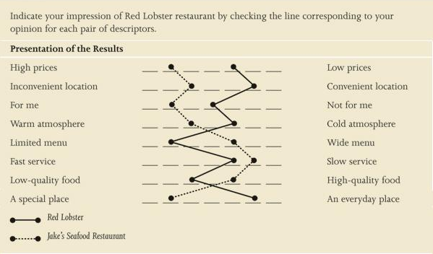
Semantic Differential Scale
Notes:
Semantic Differential Scale: Contains bipolar adjectives for various properties of the object.
OBJECTS: Red Lobster Restaurant and Jake’s Seafood Restaurant
PROPERTIES: price, location etc.
To avoid the Halo effect (all good on one side) vary positive and negative statements about the same subject.

Slide 48
Stapel Scale
Please rate the Axe Essence on the following criteria:
  +5
  +4
  +3
  +2
  +1
Scent
  -1
  -2
  -3
  -4
  -5
  +5
  +4
  +3
  +2
  +1
  Value
  -1
  -2
  -3
  -4
  -5

Slide 49
Graphic Rating Scale:
Please rate your level of comfort when asking someone on a date.
1
2
3
4
5
6
7
8
9
10
Very
Uncomfortable
Very
Comfortable
Notes:
Adult respondents
NOTE:
Instructions to the interviewer in square brackets and different font.

Slide 50
Reliability versus Validity

Slide 51
Reliability and Validity
Reliability: respondent answers in the same manner to a similar measure
  Are the findings consistent?
  Will we get the same results if we repeat the survey?
Validity: accuracy of responses to a measure
  Are we measuring what we think we’re measuring?
  Face validity

Slide 52



Reliability and Validity
Not Reliable
Not Valid
Reliable
Not Valid
Reliable
Valid
Notes:
Each dart represent a survey or a measure
Not Reliable, Not Valid:
Not Reliable: measures vary each time, not consistent
Not Valid: supposed to measure in “bull’s eye” but none of the surveys measure the correct thing (hits the target measure)
Reliable, Not Valid:
Reliable: the measures are consistent
Not Valid: supposed to measure in “bull’s eye” but none of the surveys measure the correct thing (hits the target measure)
Reliable, Valid:
Reliable: the measures are consistent
Valid: the surveys hit the target measure (i.e. measure the right thing)

Slide 53
Review of Chapter 8:
Now that you have learned:
What measurements are in marketing.
Why measurements are important.
How measurements lead to scales.
Commonly used scales in marketing.
Next:
… you will learn how to design the questionnaire

Slide 54
Chapter 9:
Designing the Questionnaire

Slide 55
The Questionnaire’s Pivotal Role in the Research Process
Survey Objectives
Respondent Information
Data Collection Method
Questionnaire
Data
Analysis
Findings
Recommendations
Managerial
Action

Slide 56
Questionnaire Development
The Questionnaire:
  translates research objectives into specific questions
  standardizes questions and response categories
Developing a questionnaire is a process …

Slide 57
Questionnaire Design Process
(10)
Implementation
(2)
Data Collection Methods
(9)
Final Copy
(3)
Question Response Format
(8)
Pretest and Revise
(1)
Survey Objectives
(4)
Question Wording
(7)
Obtain Approval
(6)
Evaluate Layout
(5)
Flow and Layout
Notes:
In the previous figure we saw that:
The Survey Objectives and the Data Collection Method lead into the Questionnaire Design.
This figure identifies:
The steps of the Questionnaire Design (shown in green).
This is not a linear process – you often have to go back to earlier steps.
Expect several drafts of the questionnaire.

Slide 58
Developing Questions
Criteria for good questions:
Does it provide the necessary decision-making information?
Does it consider the respondent’s willingness and ability to answer?
Does it allow easy editing, coding and data analysis?
Notes:
1. Does it provide the necessary decision-making information?
If the questionnaire fails to provide insights, then discard or revise.
Questionnaire must be approved by management
2. Does it consider the respondent?
Type of respondent
The interviewing environment
The questionnaire length
3. Does it allow easy editing, coding and data analysis?
Editing
Skip patterns
Coding

Slide 59
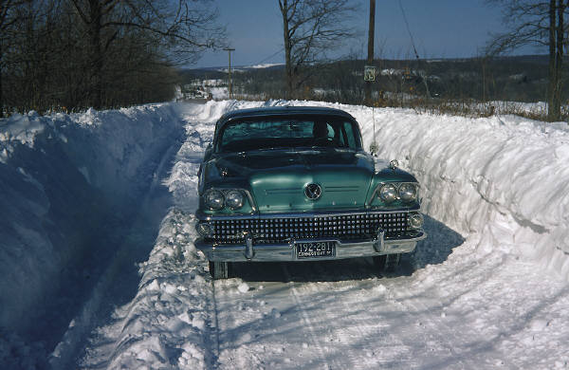
How Wording Affects Answers
Which generates more agreement?
Did you see…
a) A broken headlight?
b) The broken headlight?
Notes:
The question using the word “the” generated more “Yes” and “Don’t Know” answers than the question using the word “a”

Slide 60
Questionnaire Wording: “Do’s”
Questions should always:
Focus on a single issue or topic.
Be brief and simple.
Be crystal clear.
Notes:
See Marketing Research Insight 11.1 about developing a questionnaire in a foreign language.

Slide 61
Questionnaire Wording: “Do’s”
The question should:
Consider the respondent’s ability to answer.
Consider the respondent’s willingness to answer.
Notes:
See Marketing Research Insight 11.1 about developing a questionnaire in a foreign language.

Slide 62
Questionnaire Wording
Words to Avoid
Always
Any
Anybody
Ever
Every
Never
Extreme absolutes.
Place respondents in a situation where they must either completely agree or disagree.
“Do you always follow speed limits?”

Slide 63
Questionnaire Wording: “Do Not’s”
Questions should not:
‘Lead’ respondents to a particular answer.
Use biased or ‘loaded’ wording.
Be ‘double-barreled’.
Use words that overstate the condition…do not use ‘dramatics’.

Slide 64
“Do’s” for all questions
Keep it focused on a single topic
Keep it brief
Keep it crystal clear
How do you feel about Sears?
Please rate each aspect of Sears…
If you need repair services, would you call Sears?
When some gasoline or electric-powered product in your house breaks, do you call the Sears repair service?
Do you live within 5 blocks of Sears?
Do you live within 5 minutes of Sears?

Slide 65
“Do’s” for all questions
Consider the ability of the respondent
Consider the willingness of the respondent
During the summer months, how often do you mow your lawn?
On average, how long time does it take to mow your lawn?
How many liters of gas do you use in your lawnmower per year?
Which of the following categories best describes your annual household income?
How much do you earn per year?

Slide 66
“Do Not’s” for all questions
Don’t ask leading questions
Don’t ask loaded questions
Don’t ask double-barreled questions
Don’t use overstated questions
How important do you think it is to use car seats for infants?
Shouldn’t concerned parents use car seats?
Are you in favour or opposed to the use of car seats for infants?
Should car seats be used for our loved ones?
Do you agree or disagree that a parent who does not use a car seat is irresponsible?
Do good parents and responsible citizens use car seats?
Do you believe that a car seat can protect children in the event of an accident?
Do you believe infant car sears can protect riders from being hurt?

Slide 67
Questionnaire Organization
Questionnaire organization:
The flow and layout of the questions that make up the questionnaire.
Important because the sequence of statements in the questionnaire affect the quality of the data gathered.

Slide 68
Questionnaire Flow
Start with a proper introduction.
Use screener questions to identify qualified respondents.
Begin with a question that sparks the respondent’s interest (warm up).
Ask general questions first.
E.g., past purchase behaviour.

Slide 69
Questionnaire Flow
Ask questions that require “work” in the middle of the questionnaire.
Position sensitive questions towards the end.
Insert “prompters” and/or “bridges”.
Ask classification questions (e.g., demographic) at the very end.
Thank the respondent.
Notes:
EXAMPLE of topic flow for a general marketing survey:
Screening
Past purchasing Behaviour (what, how often, how much, level of satisfaction)
What they would like to see (organized along the 4 Ps)
“Key question” e.g. purchase intent
Classification questions (demographic and psychographis)
Fill in contact information to receive the incentive (e.g. enter a draw). This must be separate from the survey to remain anonymous.
Thank You

Slide 70
Example of Flow and Topics
Screening
Past purchase behaviour (what, how often, how much, level of satisfaction)
Preference, what they would like to see (along the 4 Ps)
“Key question” e.g. purchase intent
Classification questions (demographic, lifestyle)
Contact information (if applicable). Must be separate from the survey to remain anonymous.
Thank You
Notes:
6. Fill in contact information to receive the incentive (e.g. enter a draw).
This must be separate from the survey to remain anonymous.

Slide 71
Questionnaire Layout
Use professional layout
Allow plenty of space for open-ended questions.
Make skip patterns consistent.
Interviewer administered questionnaires: Note: make sure that instructions look different from questions. (E.g., UPPER CASE AND BOLDED)
Notes:
Use professional layout
no spelling or grammatical errors
consistent font and margins etc.

Slide 72
Questionnaire Introduction
Identifies the sponsor (if applicable)
States the purpose of the survey
Explains how the respondent was selected
States an honest estimate of how long it will take
Provides incentive for participation
Secures participation
Notes:
Introduction: for your group project do not pretend to be from a research company. Say that you are students.
For mail survey or online survey: The introduction is called a “cover letter”.
For Intercept surveys: it is common to provide your first name.

Slide 73
Screening Questions
Screening questions are used to identify respondents that fit the target population.
Research objectives should specify the type of person(s) to include in the research study.

Slide 74
Coding the Questionnaire
In closed-ended questions, we use numbers for coding response categories.
Each response category needs to have its own numerical code.
In ‘check all that apply’ questions, each option is treated like a (‘Yes/No’) question and treated like a separate question in the coding.
Notes:
For Interviewer administered questionnaire the codes can be visible on the questionnaire
For on-line surveys the codes are “behind the scene” but will still have to be defined.

Slide 75
Evaluate the Questions
Once you have designed the questionnaire, take a step back and ask yourself:
  Will the questions provide the information needed to accomplish the research objectives?
  Is the question necessary?
  Is the questionnaire too long?
Notes:
Is the questionnaire too long? “If in doubt, cut it out”

Slide 76
Pre-testing the Questionnaire
A Pre-test is a ‘dry run’ of the survey on a small number of respondents to catch any errors or unclear questions before the survey is launched.
It is important to conduct your pre-test on respondents that are qualified from the target population.

Slide 77
Over to you!
What’s wrong with the following questions?

Slide 78
Decide the Question Wording
  “Why do you like best and least about Tide?”
  Problem:
    Double-barreled: if respondent answers with ‘the price’, would that mean that they thought Tide was too expensive or a good bargain?
  The question must have a single focus

Slide 79
Decide the Question Wording
  “What kind of food do you like to have for dinner?”
  Problem:
    Question is not specific enough. It depends on where you have dinner – at home, on the run, at campus, at a restaurant, etc.
  The wording must be clear.

Slide 80
Decide the Question Wording
  “Do you like to support the less fortunate in society by giving to charity?”
  Problem:
    Biased and overstated responses
  Avoid biasing the respondent.

Slide 81
Decide the Question Wording
  “How many movies do you rent in a year?”
  Problem:
  Respondent may not know or remember.
  Consider the ability of the respondent to answer the question.

Slide 82
Decide the Question Wording
  “Do you cheat at exams?”
  Problem:
    This is a sensitive topic and one that many people may not answer honestly. Better to get the respondent to ‘project’ their thoughts/opinions onto someone or something else as in: “What do you think about people who cheat on exams?”
  Consider the willingness of the respondent to answer the question.

Slide 83
Review of Chapters 8 and 9:
Now that you have learned:
That the questionnaire has a pivotal role in the data collection process.
The steps in the questionnaire design process.
Measurements and scales.
The criteria for a good questionnaire.
… you need to start designing your questionnaire

Slide 84
REMINDER!
Peer review of questionnaires takes place next week. Every team should bring 6 copies to their Class lab.

Slide 85
REMINDER!
MIDTERM IS NEXT WEEK
Bring pencil and eraser

